Slide 1
Welcome!
On your child’s desk is a quiz about your kiddo. Feel free to answer it! I promise it’s not for a grade. ☺

Slide 2
Welcome to Open House!
Team Raines
2019-2020
“Bee” excited about 4th Grade!
music

Slide 3
Welcome!
Thank you SO much for taking the time out of your busy schedule to come to Open House. This will be a year full of academic and personal growth for
your child. ☺
Tonight’s Agenda:
All about 4th Grade
Our Daily Routine
Fourth Grade Lingo
Odds and Ends and Everything in Between
Transportation
Communication and Closing Remarks

Slide 4

At Cheatham Hill…
Mission: Develop the minds, hearts and spirits of champions.
Vision: A school of excellence where ALL students succeed.
Every Child, Every Chance, Every Day

Slide 5
All about Fourth Grade
“Teamwork makes a dream work!”
This is a transitional year, not just a “review” year.
Check agenda and work nightly.
Homework is due at 7:50. Please do not bring your child’s homework to school. They need to learn to be responsible for their work.
Please keep absences to a minimum. We cover an immense amount of content each day. Please try to make appointments as late as you can.

Slide 6
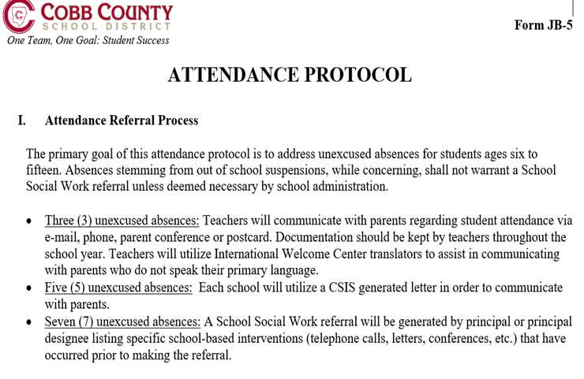
Attendance Protocol 2019-2020.docx

Slide 7
Our Daily Routine
School starts at 7:50. Please come prepared. If your child is tardy, you must sign him/her in the office. They have to be in the classroom by 7:50.
Class work-I expect 100% effort!
Homework-Should not last over 40 minutes. There is usually reading and math/spelling.
Makeup work- How ever many days your child was absent is how many days he/she needs to make the work up.
Lunch is at 11:34. We have snack starting at 9:15 Please provide appropriate snacks and water bottles that are spill proof. Birthday treats are welcomed at lunch time. ☺

Slide 8
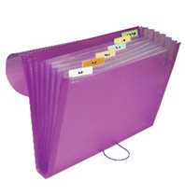
Fourth Grade Lingo
Class blog
Spelling-Differentiated lists & Spelling City https://www.spellingcity.com/
Math workbook www.connected.mcgraw-hill.com
Morning Work
RI and MI assessments
Journaling-Math, Reading/ELA, Writing
Rocket Reader Forms- Students’ responsibility to fill out
Behavior chart-sign and return on Monday. Keep work for future reference.
Use the file to organize and monitor progress.
Behavior -Champ Stars, Character Tickets

Slide 9

A Little More about Behavior…
I believe that everyone can and will succeed in
My class. I hold my students to high expectations.
I expect ALL students to come ready to learn!
Disruptive behavior will not be tolerated. Each and every one of us is
responsible for our own actions. Remember, every action has a
consequence-both the good and the bad.
The school wide behavior plan will be used in my classroom. Students who misbehave will face the following consequences. First, he/she will first be given a warning. Then, there’ll be a teacher/student conference and a consequence such as a seat change or time out at recess. If the misbehavior continues, next will be an infraction/parent phone call or email. Additional misbehavior will result in a second and/or third infraction. These can happen over the course of time-not all in a day necessarily. The fourth infraction will result in an office referral.
4th Grade Expectations PowerPoint 2019-2020.pptx

Slide 10

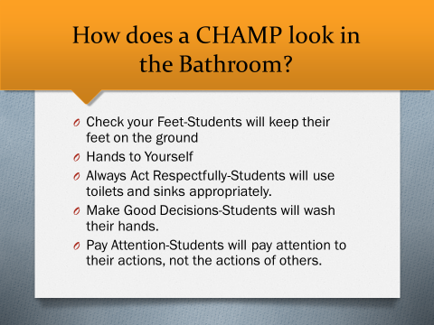
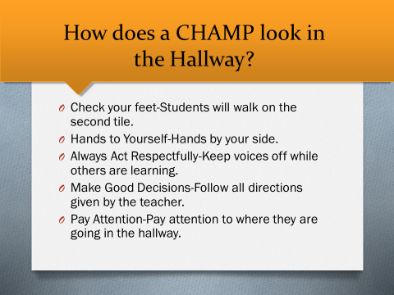
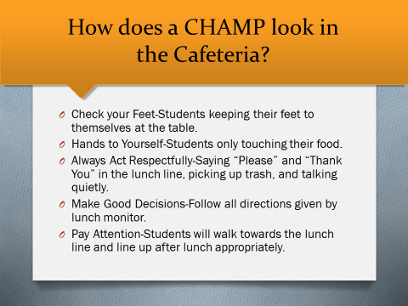

Slide 11
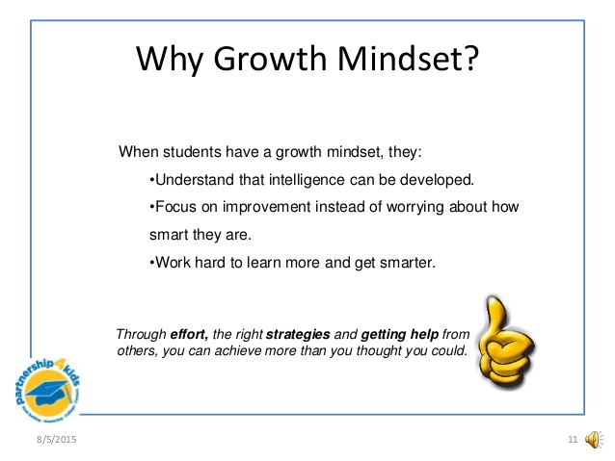
Growth Mindset

Slide 12

Voyage
Character Education Program
Respect
Patience
Self Control
Compassion
Trustworthy
Independence
Appreciation
Loyalty
Character Education: Voyage

Slide 13
Odds and Ends and Everything in Between
Grading Scale:
A=100-90 B=89-80 C=79-74 D=73-70 F=69 & below
Synergy/ParentVue-You can sign up for this in the lobby tonight. You must have photo ID and be the one who enrolled your child.
Computer Lab will start soon. Our day is Monday.
Picture Day is Wednesday, August 14th.
4th Grade Activities Letter will go home soon. Please don’t mark in the “Office Use Only” section of the envelope. I’ll send home missing paperwork at that time.
Maureen Jardin is the school nurse.
Georgia Bartlett is your child’s school counselor this year.

Slide 14
Other Teachers…
Target Tuesday-Mrs. Carothers, Mrs. Payne or Mrs. Costello
Music- Dr. Thomas-Lee
Spanish- Mrs. Gonzalez
Art- Mrs. Ralph
iLab (innovative lab)- Mrs. Courant
PE- Coach Dinic
A little about behavior during Specials…

Slide 15
Transportation
Please send in a note. Your child cannot leave school an alternate way without notifying the school of the change. Emails, texts CAN’T be accepted. Call the office before 1:45 if there is a sudden change. ☺
Car Riders vs. Walkers-Please do not park and walk in to get your children, please use the car line if you are driving to pick up your child.
Please do not drive into the bus port to drop off children in the mornings.
Please sign in at the office and get a visitors badge.
Please don’t ask staff or students to open the door.
After 2:45, students and/or parents cannot return to the classrooms.

Slide 16
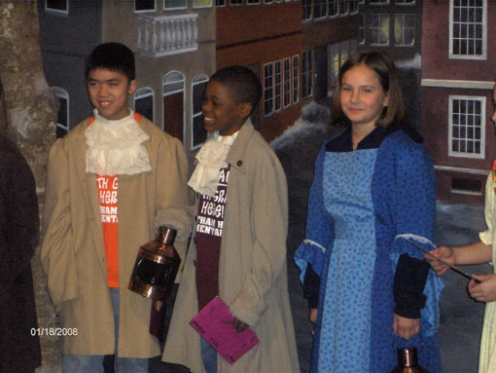

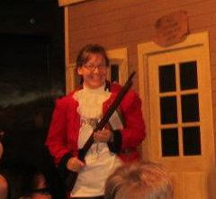



Field Trips

Slide 17
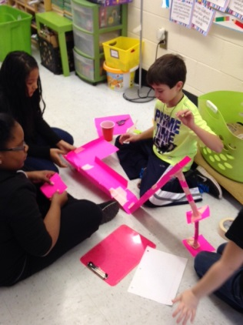
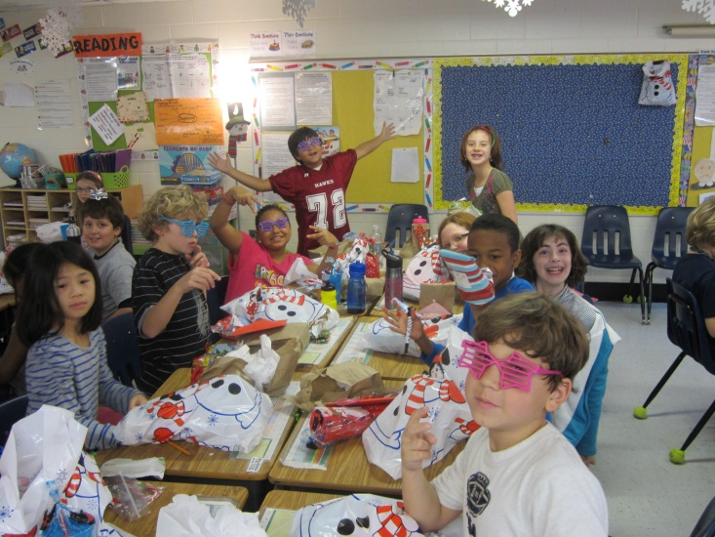
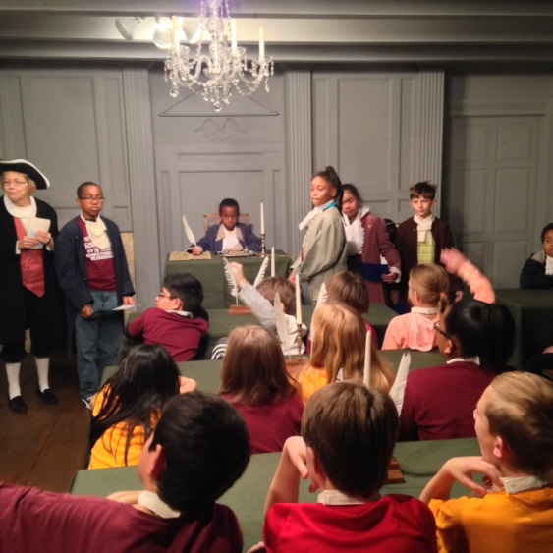
Fourth Grade is F-U-N!
STEM!

Slide 18

Communication and Closing Remarks
Please feel free to contact me at any time
at Chelsey.raines@cobbk12.org
Get updates via text:
Education is a three-part system:
your child, the parents and the teacher.

Slide 19
Thank you for coming to Open House!
Have a great evening!
Teamwork makes a dream work!

