Slide 1
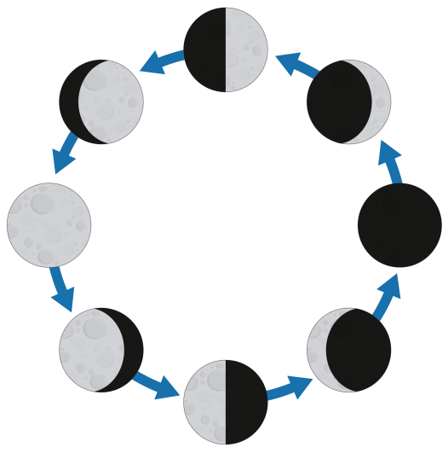
PHASES
of the
MOON
PowerPoint & Notes
Set
© Erin Kathryn 2016

Slide 2
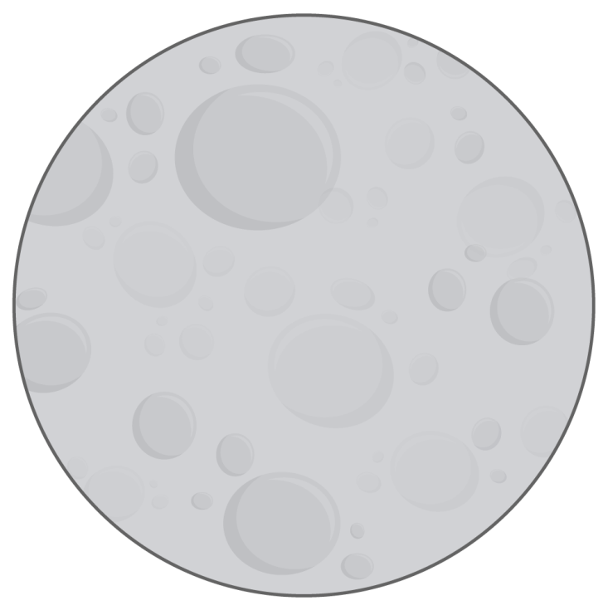
Earth’s Moon
The Moon revolves around the Earth.
It takes the Moon 27 1/3 days to revolve around Earth.
The Moon does not make its own light. It reflects the Sun’s light.
© Erin Kathryn 2016

Slide 3
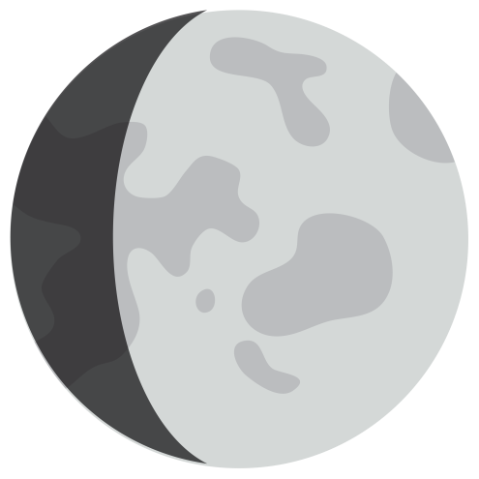
Earth’s Moon
The Moon is made of rock and dust.
It is covered with mountains, flat areas, and craters.
A crater is a dent that is shaped like bowl.
There is no air or water on the Moon.
The Moon gets very hot in the day and very cold at night.
© Erin Kathryn 2016

Slide 4
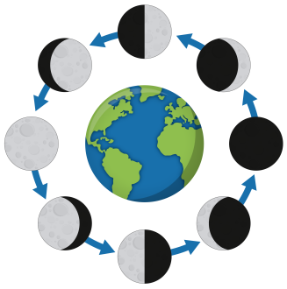
Near Side of the Moon
As the Moon revolves around the Earth, it also rotates on its axis once in 27 1/3 days.
The same side of the Moon is always facing Earth.
This side is called the near side.
The reflected sunlight makes the near side of the Moon look bright.
© Erin Kathryn 2016

Slide 5
Dark Side of the Moon
The side of the Moon that you cannot see from Earth is called the dark side.
© Erin Kathryn 2016

Slide 6
Does the Moon
change shape?
The Moon does not actually change shape.
It appears to change shape because the near side of the Moon, which faces the Earth, gets different amounts of sunlight at different times.
© Erin Kathryn 2016

Slide 7
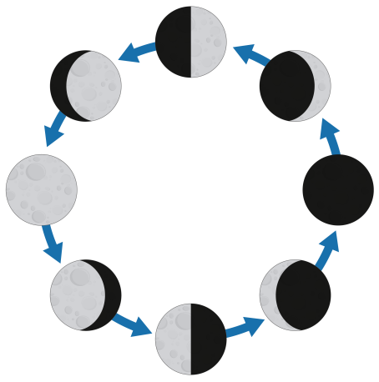
Phases of the Moon
The Moon revolves and rotates every 27 1/3 days.
During this time, the Moon takes on eight different forms.
The different ways the Moon looks throughout the month are called the phases of the Moon.
© Erin Kathryn 2016

Slide 8
New Moon
The first phase is called the New Moon.
The Moon’s near side does not get any sunlight.
The near side of the Moon is dark, and you cannot see it.
© Erin Kathryn 2016

Slide 9
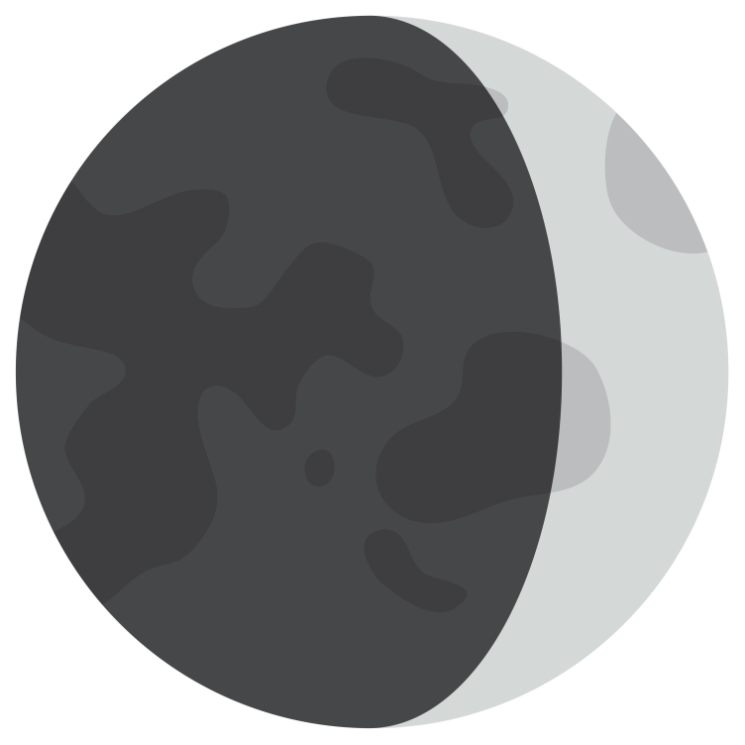
Waxing Crescent
The second phase is called a waxing crescent.
A little bit of the Moon’s near side gets sunlight.
This thin shape is called a crescent moon.
© Erin Kathryn 2016

Slide 10
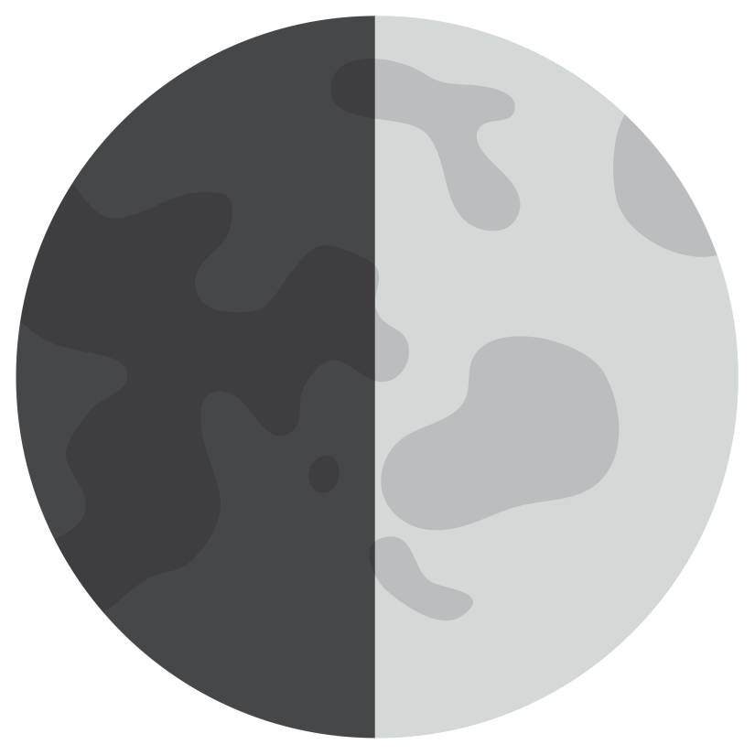
First Quarter
The third phase is called a first quarter moon.
Half of the Moon’s near side, or one quarter of the whole Moon, faces the sun.
From Earth, the quarter moon looks like half of a ball.
© Erin Kathryn 2016

Slide 11
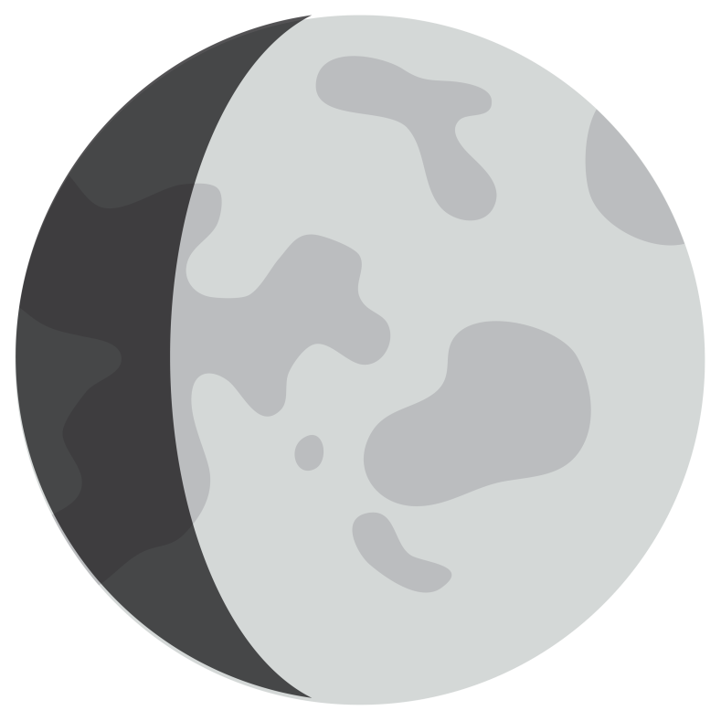
Waxing Gibbous
The fourth phase is called a waxing gibbous.
During this phase, three-quarters of the near side gets sunlight.
This gibbous shape looks like a circle with a small bite taken out of it.
© Erin Kathryn 2016

Slide 12
Full Moon
The fifth phase is called a full moon.
During this phase, the Moon has revolved halfway around Earth.
The entire near side gets sunlight.
From Earth, this phase looks like a whole ball.
© Erin Kathryn 2016

Slide 13
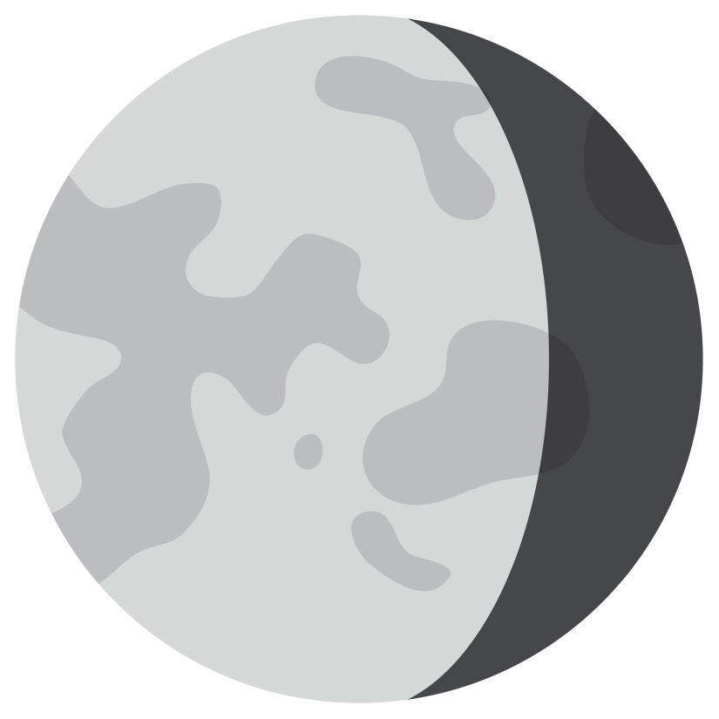
Waning Gibbous
The sixth phase is called a waning gibbous.
A little bit less of the Moon’s near side gets sunlight.
This waning moon looks like a circle with a small bite taken out of the right side.
© Erin Kathryn 2016

Slide 14
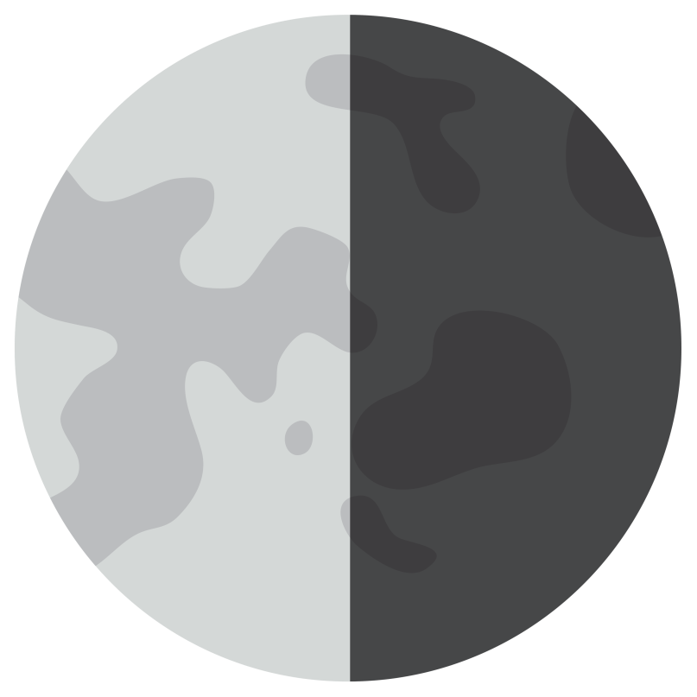
Third Quarter
The seventh phase is called a third quarter moon.
Similar to the third phase (First Quarter), it looks like half of a ball to people on Earth.
During this phase, the left side is lit up.
© Erin Kathryn 2016

Slide 15
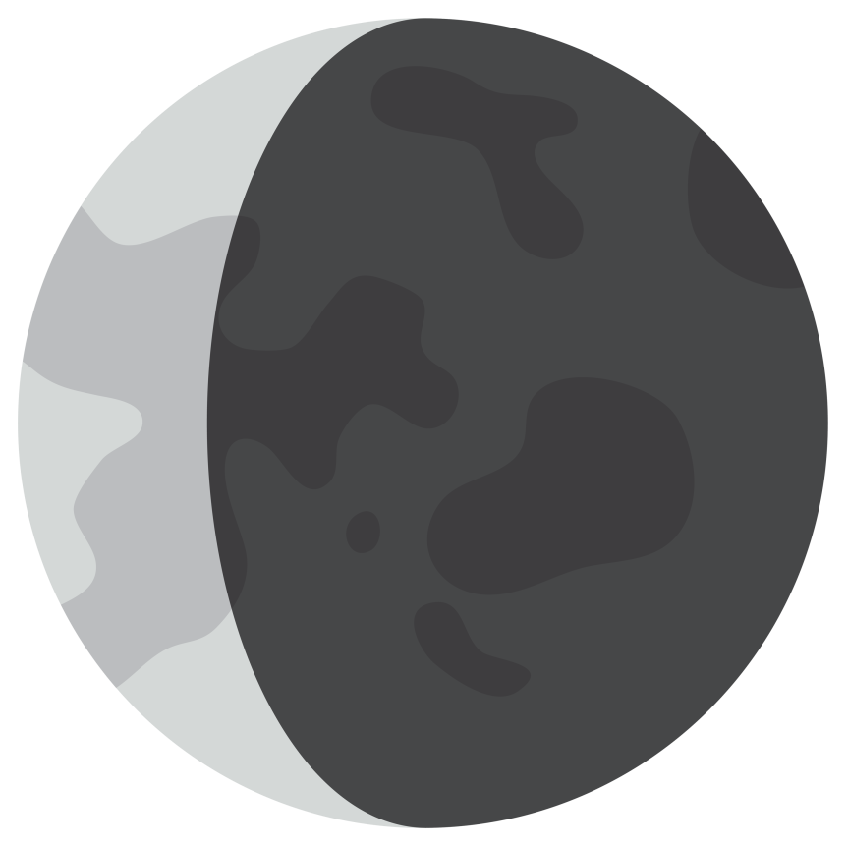
Waning Crescent
The eighth phase is called a waning crescent.
Similar to the second phase, they are both thin crescents.
After this phase, a new moon happens again and the phases start all over again.
© Erin Kathryn 2016

Slide 16
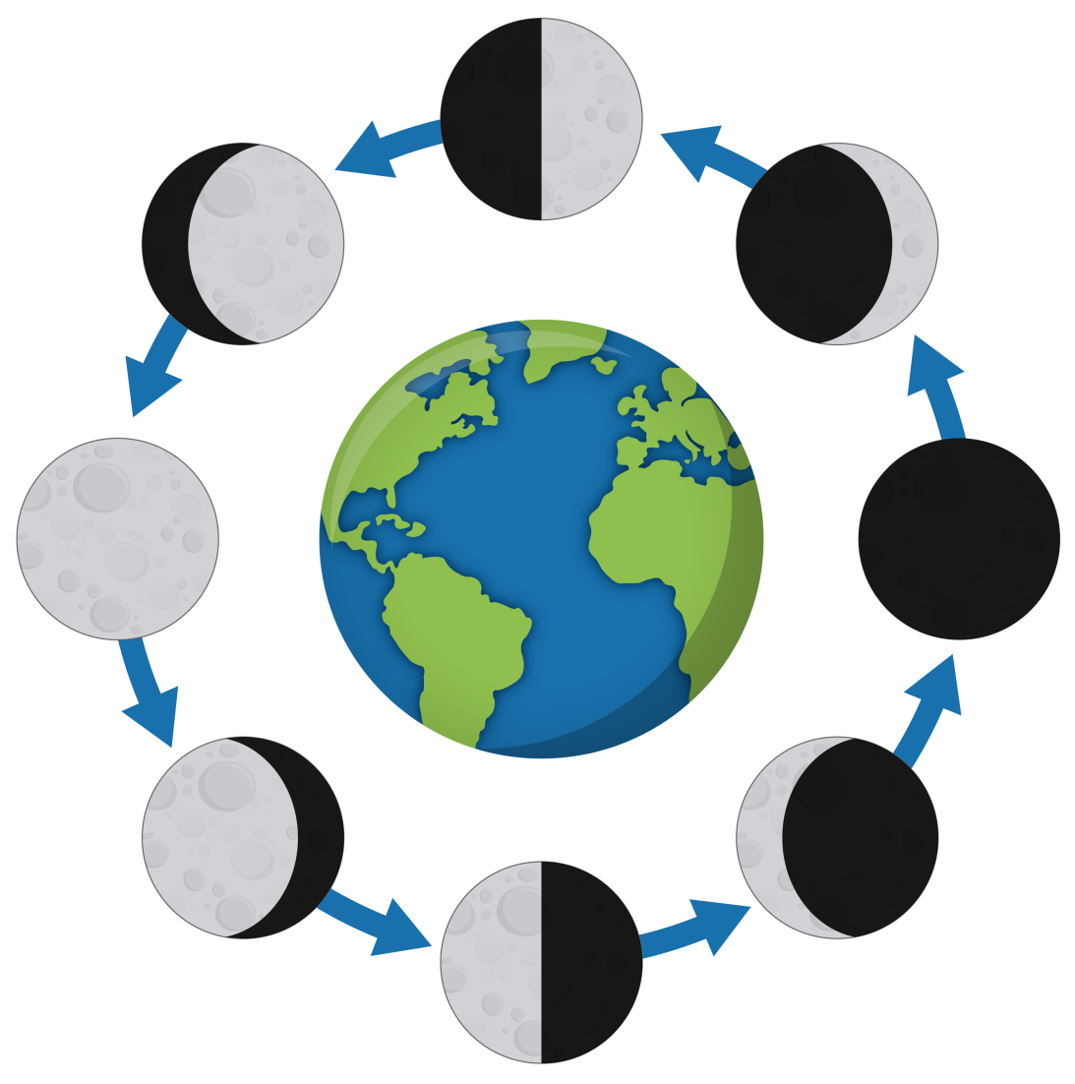
Phase of the Moon
first quarter
waxing gibbous
waxing crescent
sun
full moon
new moon
waning gibbous
waning crescent
third quarter
© Erin Kathryn 2016

Slide 17
Phase of the Moon
________________
________________
________________
sun
___________
___________
_______________
________________
________________
© Erin Kathryn 2016

Slide 18
Reflection
Tell 3 facts about the surface of the moon.
Why does the same side of the Moon always face Earth?
What are two different ways that the Moon moves?
What is the changing shape of the Moon called?
© Erin Kathryn 2016

Slide 19
Reflection
Tell 3 facts about the surface of the moon.
-The Moon is made of rock and dust.
-It is covered with mountains, flat areas, and craters.
-There is no air or water on the Moon.
-The Moon gets very hot in the day and very cold at night.
© Erin Kathryn 2016

Slide 20
Reflection
Why does the same side of the Moon always face Earth?
The Moon revolves and rotates the same way every 27 1/3 days.
© Erin Kathryn 2016

Slide 21
Reflection
What are two different ways that the Moon moves?
The Moon revolves around Earth every 27 1/3 days.
The Moon rotates on its axis every 27 1/3 days.
© Erin Kathryn 2016

Slide 22
Reflection
What is the changing shape of the Moon called?
The changing shapes of the Moon are called the phases of the Moon.
© Erin Kathryn 2016

