Slide 1

Name:

Slide 2
Directions:
1. Read over the type of poem and example.
2. Create your own amazing poem on the right side.
Double click inside the light blue text box.
Type your spectacular poem using the example on the left.
Resize your poem to fill up the space.
(Highlight the text and change the font size.)
You can also use choose colorful text, different fonts and images.
3. Save it to your OneDrive account and send it to me at
julie.Traylor@cobbk12.org by 5/15.
Make sure you show your BEST effort and you follow the formats carefully! I can’t wait to read your poetry portfolio! ☺

Slide 3
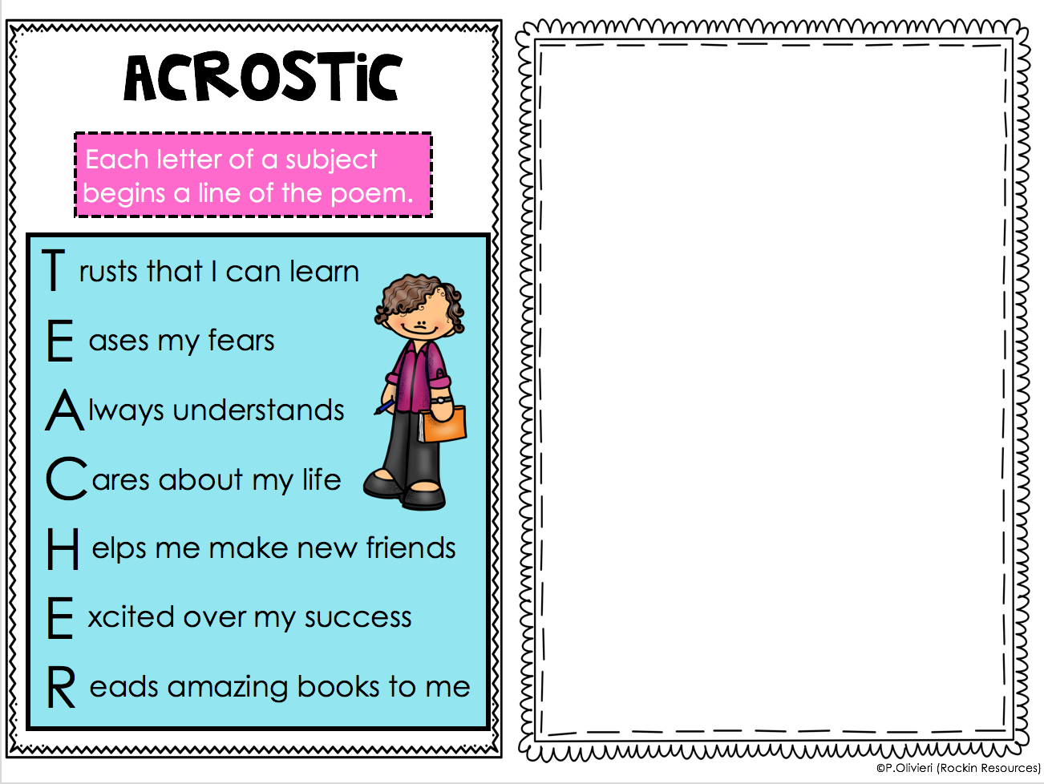

Slide 4
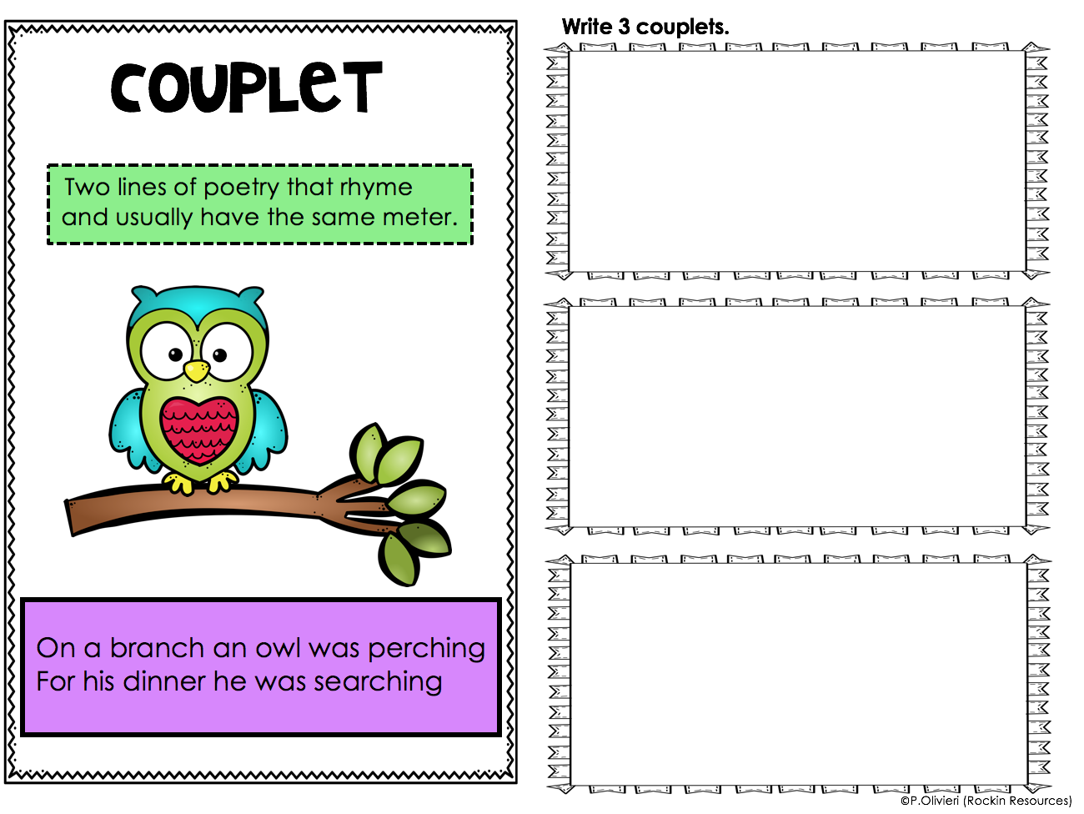

Slide 5
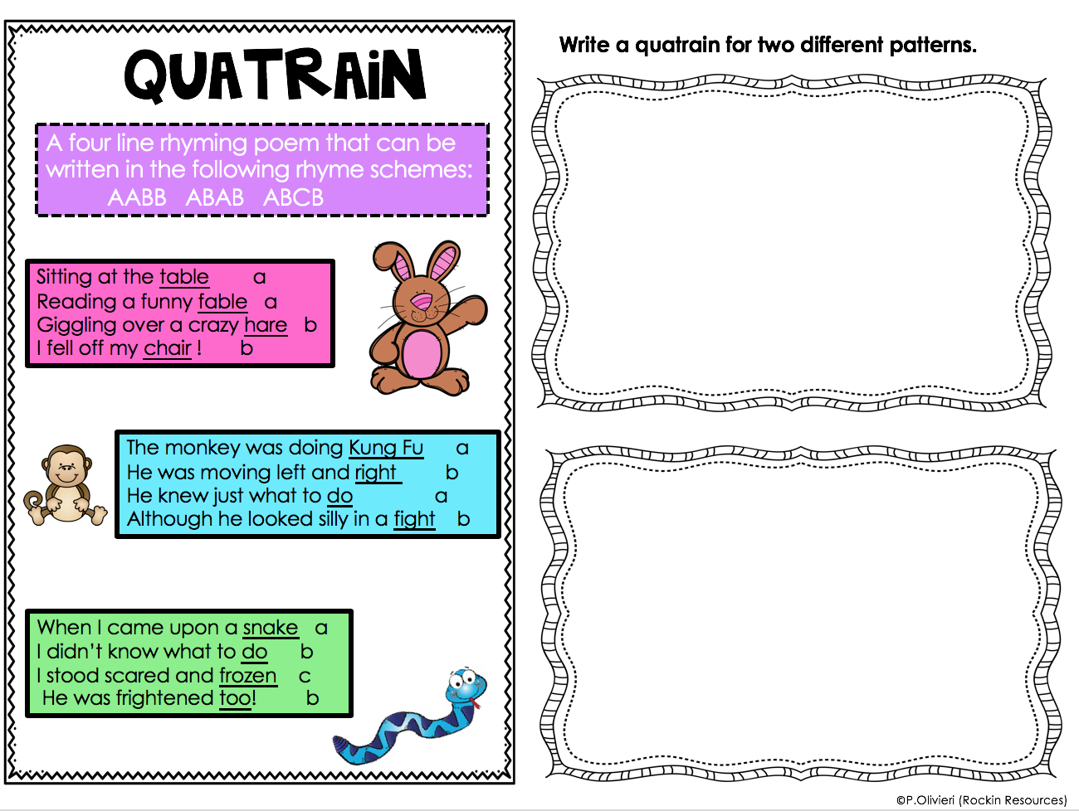

Slide 6
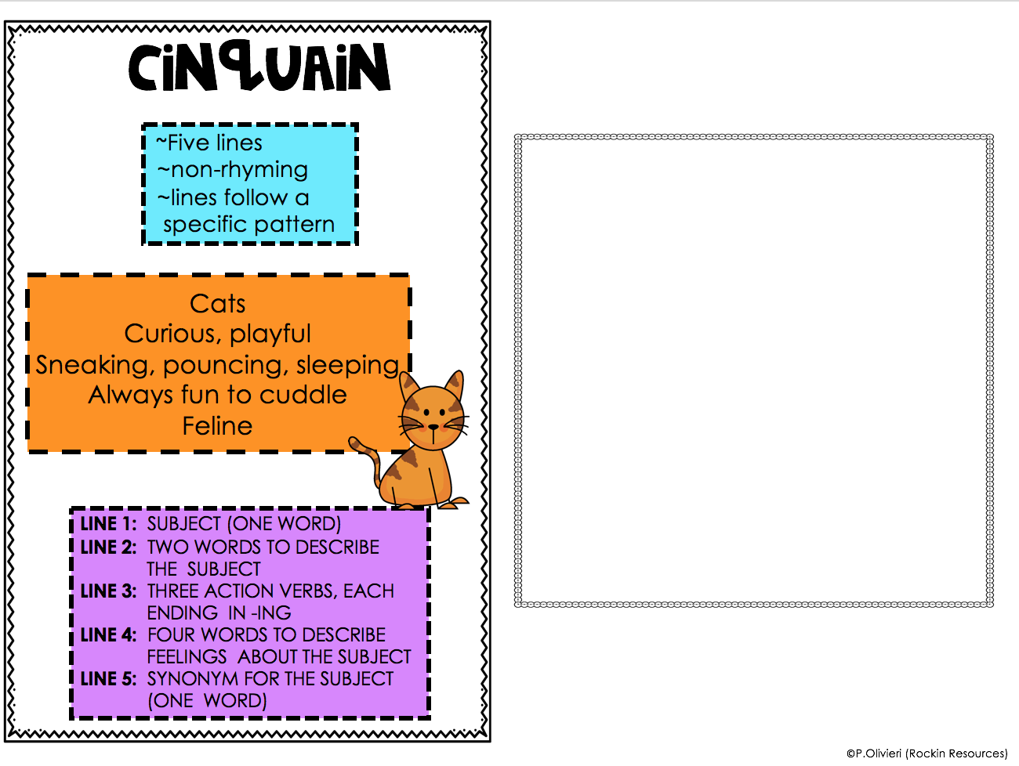

Slide 7
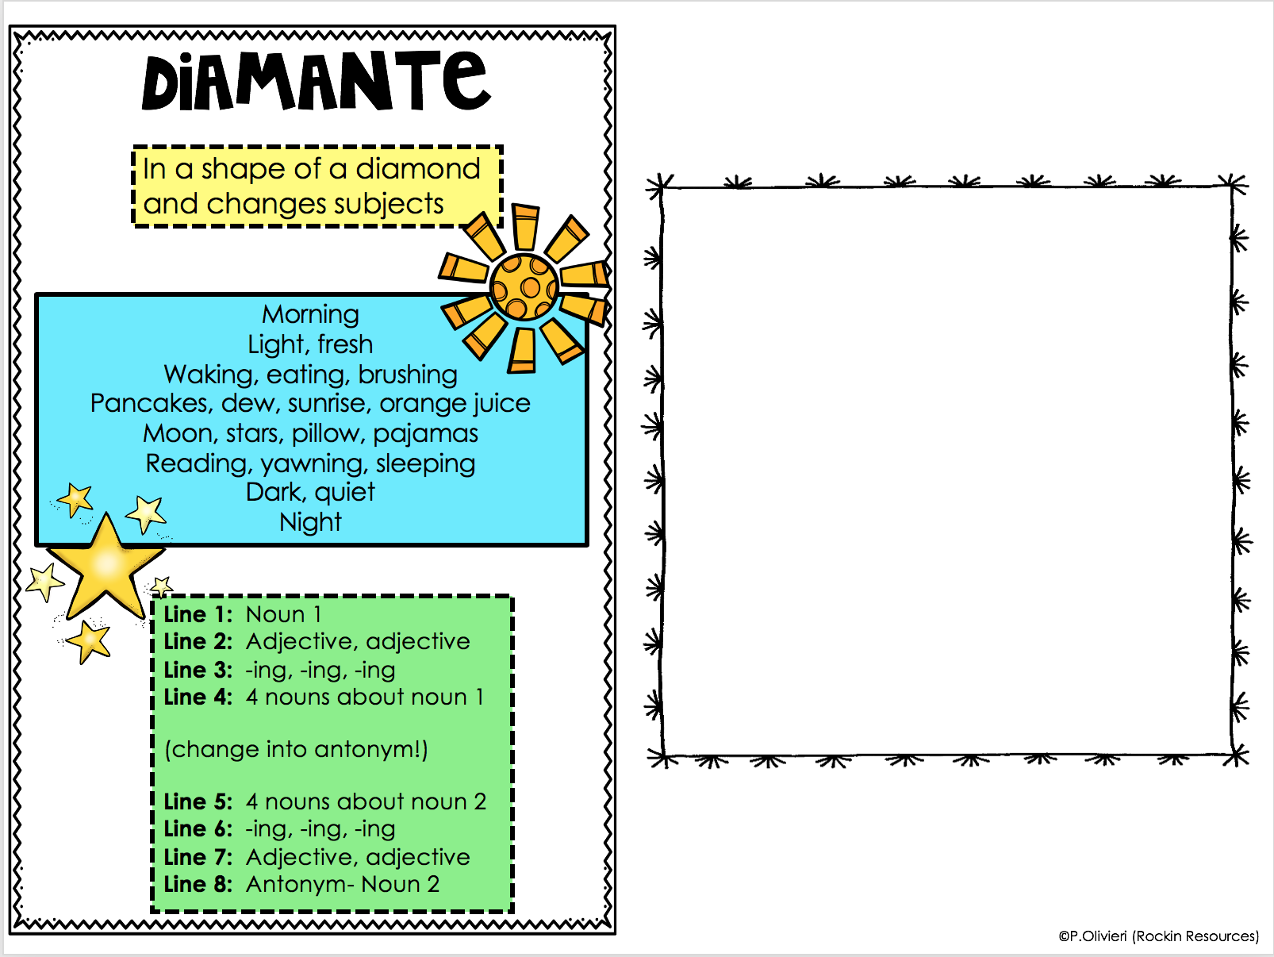

Slide 8
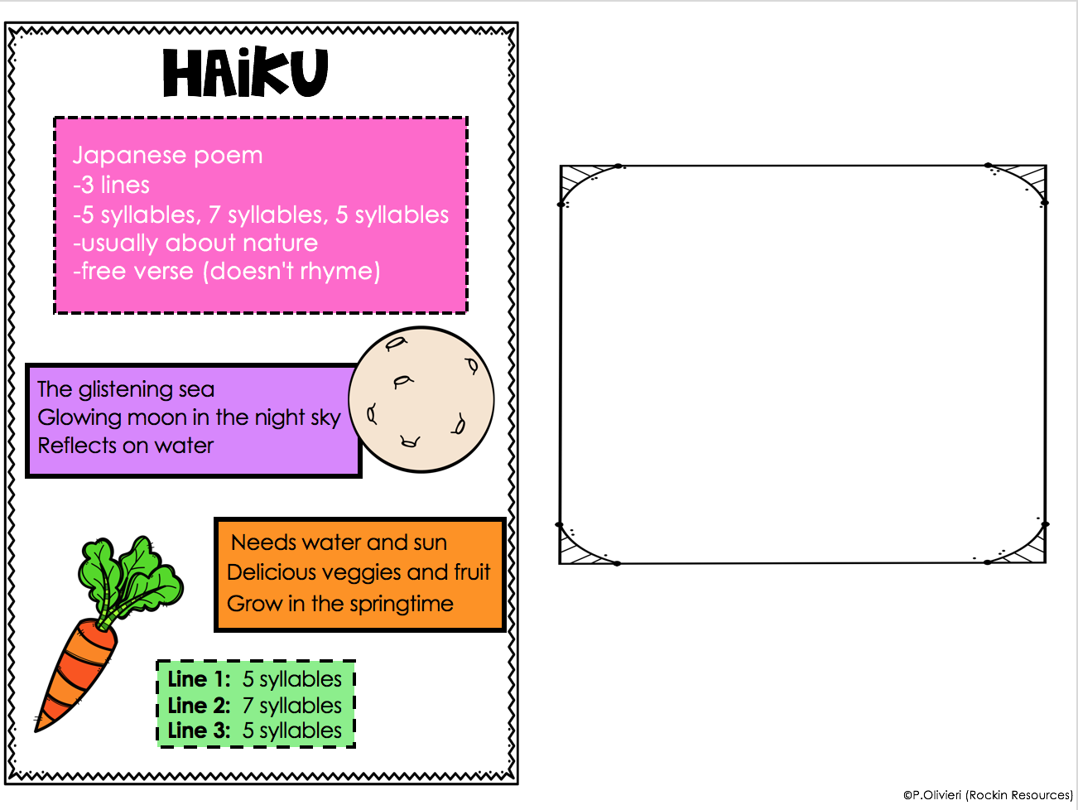

Slide 9
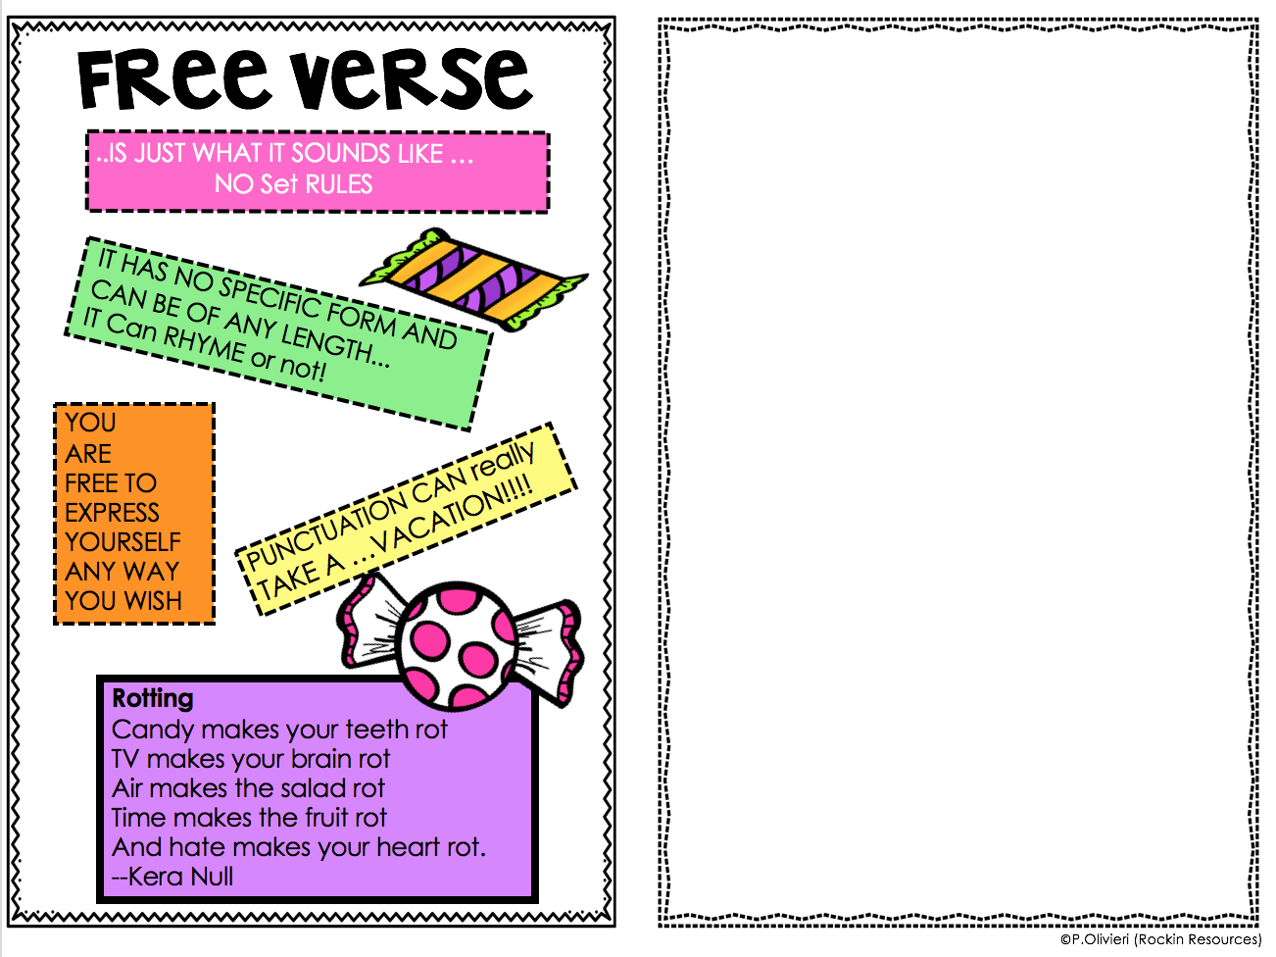

Slide 10
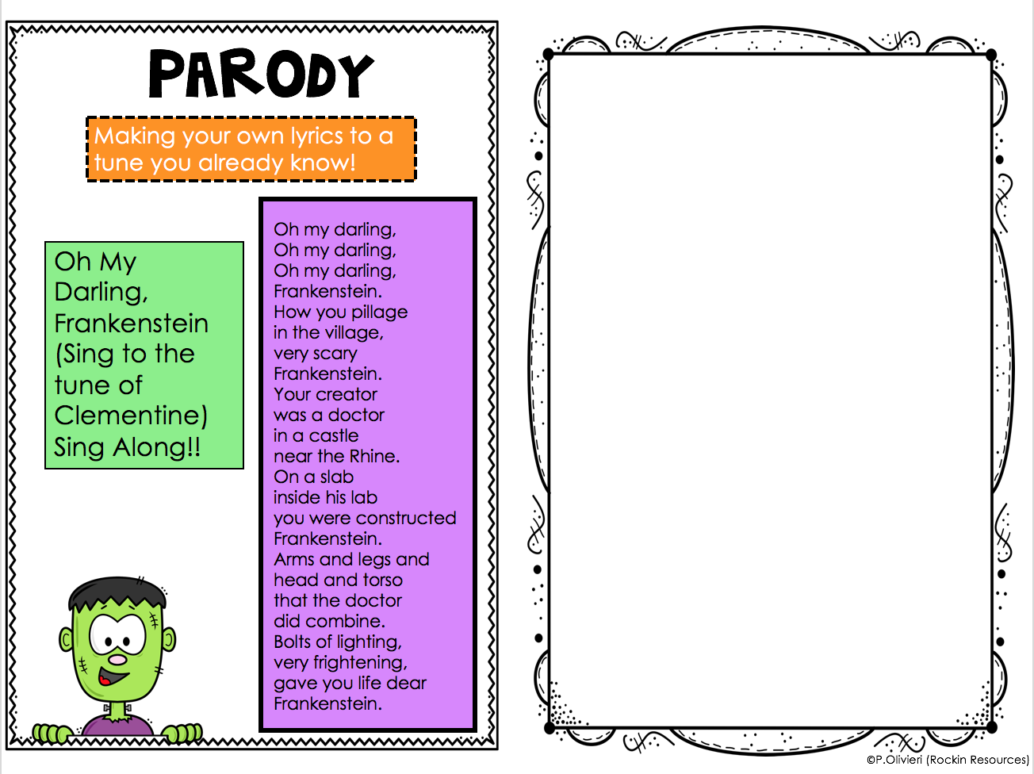

Slide 11
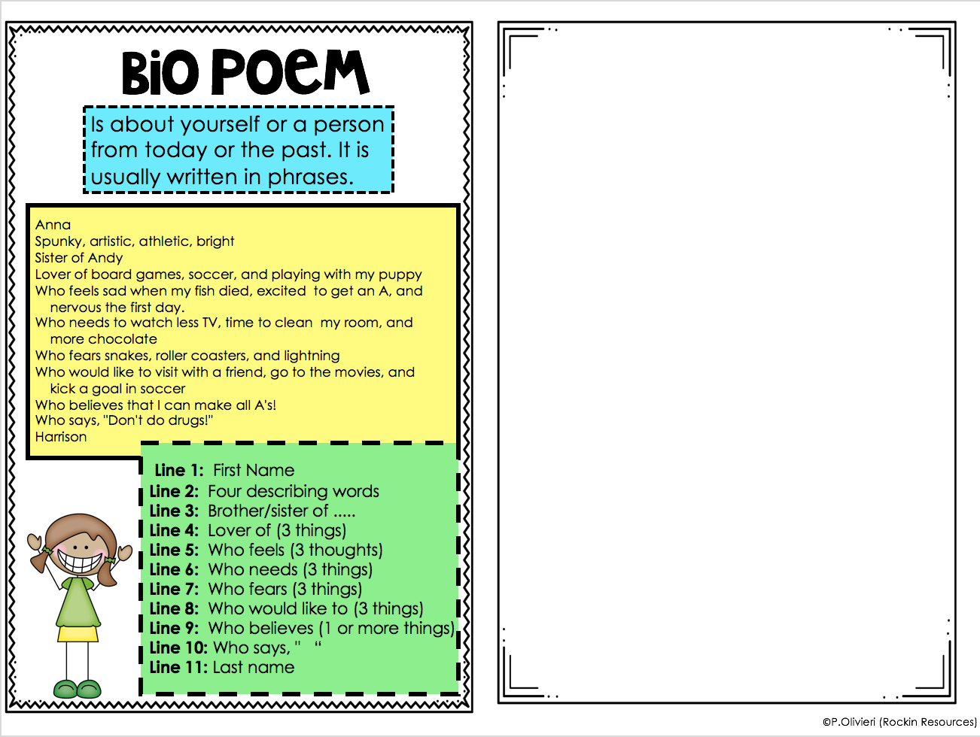

Slide 12
